Slide 1
Mobile Edition
N.N.
NN@qt.qio
February 2017 – Based on Qt 5.8

Slide 2
Contents
Qt in Mobile Platforms
Mobile APIs
Android
iOS
Application Lifecycle

Slide 3
Objevtives
Qt on mobile platforms
Mobile user experience
Native API access
Mobile APIs
Sensors
Bluetooth
In-app purchasing
Any questions at any point – please do not hesitate to ask!

Slide 4
Qt in Mobile Platforms

Slide 5
Qt in Mobile Platforms
Objective is to support Qt-based app development in mobile platforms
Not to provide all mobile APIs as cross-platform APIs
Qt-based frameworks for mobile game and app development exist, for example V-Play https://v-play.net
Mobile offering may be extended with partner contributions or acquisitions in the future
Qt mobile APIs
Sensors
Positioning
Location
NFC
Bluetooth
In-app purchasing

Slide 6
Platform-Dependent Variations
Macro
Line-by-line variation
Function implementation
Function signature kept the same
Implementation differs
Class implementation
Header/interface kept the same
The whole implementation differs
Separate source files: myclass.h, myclass_unix.cpp, myclass_win.cpp
Plug-in
Usually requires a unified way to implement plug-ins
orientation: (Qt.platform.os === “osx" ||
Qt.platform.os === "ios") ? -90 : 0

Slide 7
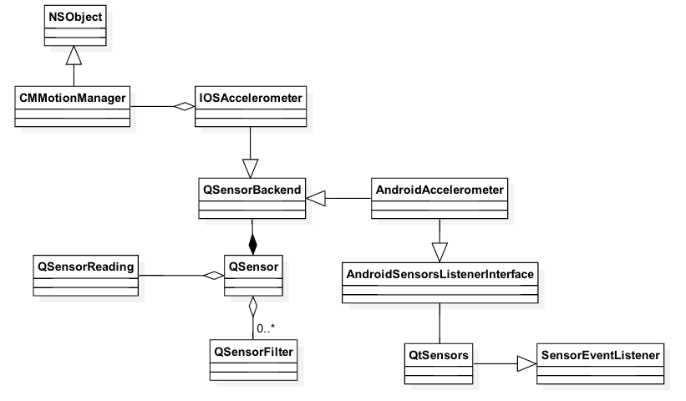
Mobile APIs – Architectures
Backend with platform-dependent code
Sensors, positioning, location
Similarities to P-IMPL
Pre-processor directives and platform-dependent source code
Bluetooth
NFC
In-app purchasing
Calling non-existent functionality just does not do anything

Slide 8
Mobile API Usage – Sensors
// start the sensor
QSensor sensor("QAccelerometer"); sensor.start();
// later
QSensorReading *reading = sensor.reading();
qreal x = reading->property("x").value<qreal>();
qreal y = reading->value(1).value<qreal>();
import QtSensors 5.0
Text {
TiltSensor {
id: tilt; active: false
}
onSomeSignal: {
tilt.active = (tiltStart.text === "Start");
text: "X Rotation: " + tilt.xRotation
text: "Y Rotation: " + tilt.yRotation
text: "Proximity: " + (proxi.active ? (proxi.reading.near ? "Near" : "Far") : "Unknown")

Slide 9
Mobile API Usage – In-App Purchasing
Supports Android Google Play and iOS App Store
Makes it easy to monetize your application (new features, new items etc.)
Makes it easier to use the credit card information on your platform
Publish your application (possible using alpha or beta testing) and add new product in Google Play
Product Id
Product Type – Only Managed products supported by Qt
Price information
Activate the product
For iOS, use iTunes Connect to register your application and products
Qt supports only Consumable and Non-Consumable types
Add the name, description, screen shot, and pricing information of your product
Both C++ and QML types available

Slide 10
Qt Positioning
In QML, the Position element provides the user device’s current position
Coordinate, speed, time stamp
Using the PositionSource element,
The source (backend) may be specified (satellite/non-satellite, socket)
Update interval may be set
Supported and preferred positioning methods may be read
Position type property position may be read
import QtPositioning 5.2
PositionSource {
id: src
updateInterval: 1000
active: true
onPositionChanged: {
var coord = src.position.coordinate;
console.log("Coordinate:", coord.longitude, coord.latitude);

Slide 11
Qt Positioning – Location and Address
Location
Coordinate
Address
Bounding box
Typical use case:
Location query with GeocodeModel
GeocodeModel {
id: model
plugin: mapPlugin
}
onSomeSignalHandler: {
model.query(“Hatanpään …, Tampere, Finland”); // Address, string, coordinate
model.update();

Slide 12
Location Backend Abstraction – Plugin
Nokia (“here”), Open Street Maps (“osm”), and MapBox (“mapbox”) supported
Each plugin has plugin-specific configuration parameters
Possible to set required features
Plugin {
id: mapPlugin
name: "osm"
// preferred: [ "osm", "here" ]
required: Plugin.RoutingFeature
PluginParameter { name: "name"; value: "value" } }a

Slide 13
Location – Map
Displays the map
Supports all Qt gestures (pinch, pan, swipe)
Can show annotations (from the model) MapRectangle, MapQuickItem, MapItemView
Can show routes MapRoute
Map type (style: satellite, street, terrain; mobile, night)
Map {
id: map
plugin: mapPlugin
center {
latitude: positionSrc.position.coordinate.latitude
longitude: positionSrc.position.coordinate.longitude
}
zoomLevel: 8.0 // >= 0

Slide 14
Location – Places & Routes
Use the corresponding model to query for places or routes
PlaceSearchModel { searchTerm: “gasoline”; searchArea: currentCoordinate }
RouteModel { query: myQuery } // queryObject.addWaypoint(coordinate)
Use any view to show the model content as usual
For route data, there is already a delegate type MapRoute
Map {
RouteQuery { id: routeQuery }
RouteModel { id: routeModel; plugin: mapPlugin; query: routeQuery }
MapItemView { model: routeModel; delegate: routeDelegate }
Component { id: routeDelegate
MapRoute {
route: routeData
line.color: "blue"
line.width: 5
opacity: 0.8

Slide 15
Mobile API Usage – In-App Purchasing
Register your products
Store {
Product {
id: myCoolProduct
identifier: "consumableProduct"
type: Product.Consumable
// Product.Unlockable
Implement UI elements to purchase products
Native functionality will handle the purchasing process (ask passwords, if needed etc.)
MouseArea {
enabled: !myCoolProduct.purchasing &&
myCoolProduct.status ===
Product.Registered
onClicked: {
myCoolProduct.purchasing = true;
myCoolProduct.purchase();

Slide 16
Cross-Platform APIs: Connectivity
NFC
NFC tag detection
Reading and writing NDEF messages, NDEF message handler registration
File and message sharing
Bluetooth
Local device information
Device and service discoveries
OBEX object push profile (not on Android)
Serial port profile via RFCOMM

Slide 17
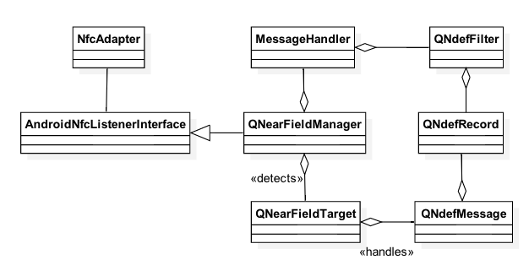
NFC
m_manager = new QNearFieldManager(this);
connect(m_manager, SIGNAL(targetDetected(QNearFieldTarget*)), this,
SLOT(targetDetected(QNearFieldTarget*)));
connect(m_manager, SIGNAL(targetLost(QNearFieldTarget*)), this,
SLOT(targetLost(QNearFieldTarget*)));
m_manager->startTargetDetection();

Slide 18
Bluetooth
QBluetoothService DiscoveryAgent
QBluetoothSocket
QBluetoothServer
QBluetoothSocket
1. listen()
3. serviceDiscovered()
2. Register service
4. connectToService()
8. signal connected()
5. signal newConnection()
9. write()
10. signal bytesWritten()
6. nextPendingConnection()
7. signal readyRead()
Client
Server

Slide 19
QBluetoothServiceInfo
Bluetooth service attributes
Protocol, port, description, name, provider, service class Uuid
Defined as name and sequence pairs
Set with convenience functions
serviceInfo.setServiceUuid(QBluetoothUuid(serviceUuid));
Or with generic setAttribute() function
QBluetoothServiceInfo::Sequence publicBrowse;
publicBrowse << QVariant::fromValue(QBluetoothUuid(QBluetoothUuid::PublicBrowseGroup));
serviceInfo.setAttribute(QBluetoothServiceInfo::BrowseGroupList, publicBrowse);

Slide 20
Bluetooth
rfcommServer = new QBluetoothServer(QBluetoothServiceInfo::RfcommProtocol, this);
connect(rfcommServer, SIGNAL(newConnection()), this, SLOT(clientConnected()));
bool result = rfcommServer->listen(localAdapter);
// Set service attributes
serviceInfo.registerService(localAdapter);
socket = new QBluetoothSocket(QBluetoothServiceInfo::RfcommProtocol);
socket->connectToService(remoteService);
connect(socket, SIGNAL(readyRead()), this, SLOT(readSocket()));
connect(socket, SIGNAL(connected()), this, SLOT(connected()));
connect(socket, SIGNAL(disconnected()), this, SIGNAL(disconnected()));

Slide 21
Bluetooth QML Client
Device and service discovery
BluetoothDiscoveryModel
Set the mode (full, minimal, device) and UUID to limit services
Connect to deviceDiscovered() or serviceDiscovered() signals
Bluetooth service information
BluetoothService
Returned by the service discovery
Device address and name, service name, protocol, and description
Service UUID
Device and service connection and communication
BluetoothSocket
Set the service
Check the state (unconnected, connecting, connected, listening, closing)
Read and write data (property stringData)

Slide 22
Bluetooth QML Client
BluetoothDiscoveryModel {
id: btModel
running: true
discoveryMode: BluetoothDiscoveryModel.MinimalServiceDiscovery
onServiceDiscovered: {
socket.setService(service)
}
uuidFilter: "e8e10f95-1a70-4b27-9ccf-02010264e9c8"
}
BluetoothSocket {
id: socket
connected: true onSocketStateChanged: {
console.log("Connected to server")
}
onStringDataChanged: {
console.log("Received data: “, socket.stringData);
}
}

Slide 23
Android

Slide 24
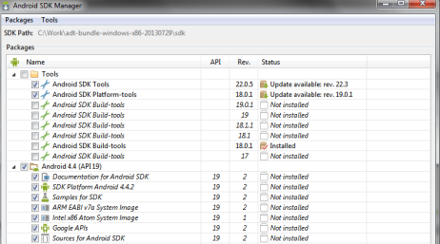
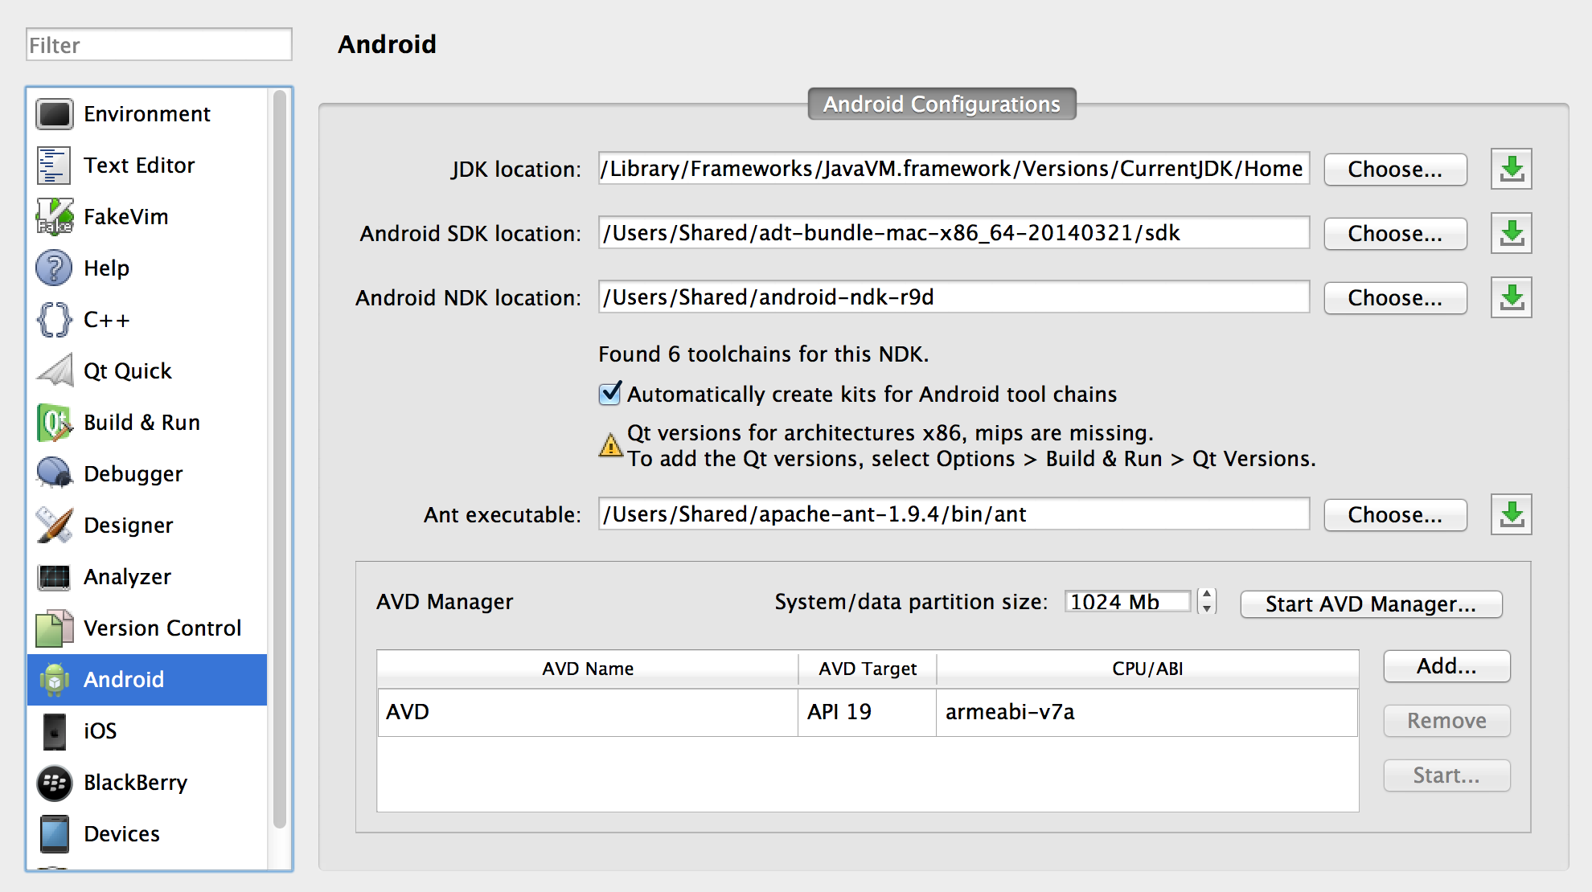
Qt in Android – Tooling

Slide 25
Qt in Android – Application Building Blocks
All modules supported except Qt WebEngine, Qt NFC, Qt SerialPort and platform specific ones
Android resources
Accessible using schema assets://

Slide 26
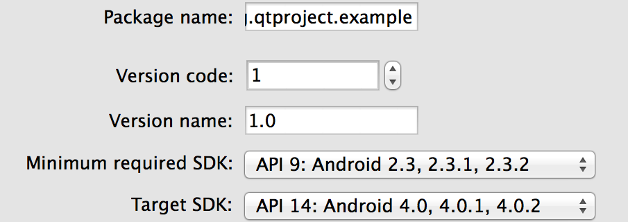
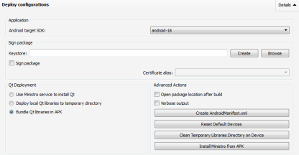
Building, Package Creation, Signing, Deployment
Almost everything supported in QtCreator (Projects mode: Run Settings)
Signing, icons, permissions, version management, library deployment
Permissions will be selected automatically based on Qt headers
Three deployment options
Projects > Run > Deploy configurations
Using Ministro, temporary directory for Qt libs, APK
Publishing in Google Play
Signed APK can be created in QtCreator
Login to Goole Play and upload your app

Slide 27
Native Apps Android – Consists of Application Components
Activity | One UI in the application Typically full screen Compare to a page / view
Broadcast Receiver | Response to an event or a notification Can launch an application Incoming phone call, network connection established
Service | Background task without the UI Keeps running while user navigates to another application Music Player, Location Tracker
Content Provider | Shares content between apps (processes) Contacts
APK #1/Process
APK #2/Process

Slide 28

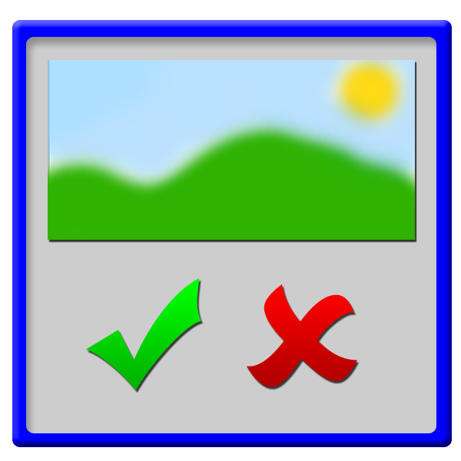
Android Activity
onCreate()
onStart()
onResume()
onPause()
onStop()
onDestroy()
onTouchEvent()
onUserInteraction()
etc.
Looper
<<main thread>>
Activity

Slide 29
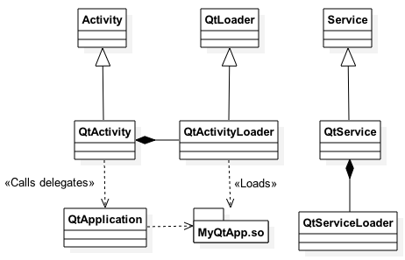
Qt Android Apps
Native process with a GUI thread, running a Dalvik VM
Launces an activity
Activity uses the loader to load Qt libs using Ministro or bundle
Creates QtApplication , which works as a delegate for event handling
Events handled natively in the activity => propagated to QPA plugin using the application delegate
In C++, main integration takes place in androidjnimain.cpp (part of the Andoird QPA plug-in)
Creates a new thread and starts handling Qt events in the thread
Uses JNI to access Android native functions (application state, screen orientation, create Drawables, show status bar etc.)

Slide 30
Native APIs Android
Provided by Qt Android Extras module
QAndoirdJniEnvironment – attaches your thread to Dalvik VM
QAndroidActivityResultReceiver – implement to get notifications about QtActivity start activity functions
QAndroidJniObject – provides APIs to call Java methods
Call static and non-static methods, set and get object fields
You need to provide a signature of a method “(Arguments)ReturnType”
All object types are returned as QAndroidJniObject

Slide 31
Arguments and Return Types in Signatures
jboolean | Z |  | void | V
jbyte | B |  | custom | L<fully qualified name>
jchar | C |  | jobject | Ljava/lang/Object;
jshort | S |  | jclass | Ljava/lang/Class;
jint | I |  | jstring | Ljava/lang/String;
jlong | J |  | jthrowable | Ljava/lang/Throwable;
jfloat | F |  | jobjectArray | [Ljava/lang/Object;
jdouble | D |  | jarray | [<type>

Slide 32
Java Class
package io.qt.training;
// Create a source folder by using the fully qualified class name
class Dummy {
public static int simpleMethod(String string) {
String anotherString = new String(“Hello”);
if (string.startsWith(anotherString))
return checkUsingNativeCode(string);
else
return 0;
}
private static native int checkUsingNativeCode(String string);
}

Slide 33
JNI – Calling Java Methods from C++
QAndroidJniObject string = QAndroidJniObject::fromString("Hello World");
QAndroidJniObject example = QAndroidJniObject::callStaticObjectMethod(
”io/qt/training/Dummy", ”simpleMethod"
”(Ljava/lang/String;)I"
string.object<jstring>());

Slide 34
JNI – Calling C++ Methods from Java
static void callFromJava(JNIEnv *env, jobject thiz, jstring string)
{
QString aString(env->GetStringUTFChars(string, 0));
}
void registerNativeMethods()
{
JNINativeMethod methods[] {{"checkUsingNativeCode", "(Ljava/lang/String)I",
reinterpret_cast<void *>(callFromJava)}}; QAndroidJniObject javaClass("io/qt/training/Dummy");
QAndroidJniEnvironment env;
jclass objectClass = env->GetObjectClass(javaClass.object<jobject>());
env->RegisterNatives(objectClass, methods, sizeof(methods) / sizeof(methods[0]));
env->DeleteLocalRef(objectClass);
}

Slide 35
Custom Activity
Subclass QtActivity Java class or implement new classes
Implement Java functions to
Create new activities
Read data from content providers (calendar, camera, phone book)
Send intents for broadcast receivers (or receive broadcast message yourself)
Start services (possibly running in the background)
Implement corresponding C++ functions and expose to QML, if needed
Use Qt Android Extras module classes to implement the glue between C++ and Java

Slide 36

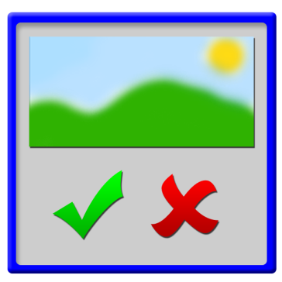

Intents
Message to communicate with other UI components possibly in other threads or processes
Intent Filter
Activity
Context.startActivity() or
Activity.startActivityForResult()
getIntent()
Activity.setResult()
onAcitivityResult()

Slide 37
QtAndroid Namespace
Useful functions for Android development
QNadroidJniObject QtAndroid::androidActivity();
QNadroidJniObject QtAndroid::androidContext();
QNadroidJniObject QtAndroid::androidService();
void QtAndroid::runOnAndroidThread(const Runnable &runnable);

Slide 38
iOS

Slide 39
Qt in iOS – Tooling
Xcode and Xcode command line tools are enough
Apple developer id
Register your device
Developer/distribution provisioning profile
Associates together device id, application bundle id, and developer certificate
Developer/distribution certificate

Slide 40
Qt in iOS – Application Building Blocks
iOS fonts and icons
application icon must be deployed in the bundle and defined in the info.plist file using CFBundleIconFiles key
fontFiles.files = fonts/*.ttf
fontFiles.path = fonts
QMAKE_BUNDLE_DATA += fontFiles
iOS assets
assets_catalogs.files =
$$files($$PWD/*.xcassets)
QMAKE_BUNDLE_DATA += assets_catalogs

Slide 41
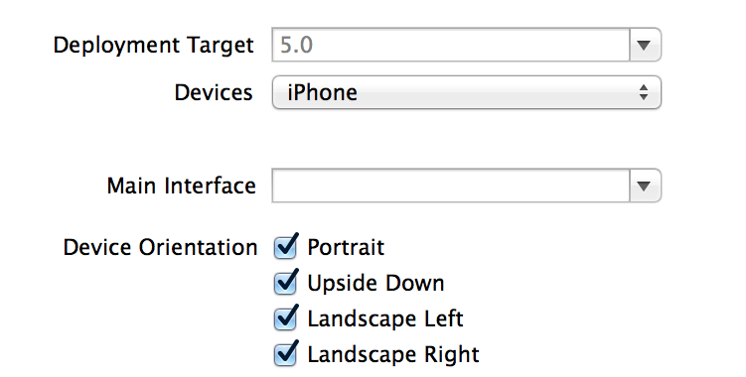
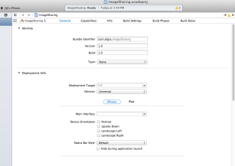
Building, Package Creation, Signing, Deployment
You may build and deploy your application to iOS in QtCreator
Qt iOS project contains Xcode project file (.xcodeproj)
You may open the project in Xcode and build it there
Package settings in Xcode
Icons, orientations, application bundle, version number, target devices, libraries, capabilities (In-App Purchase)
Publish using iToons Connect

Slide 42
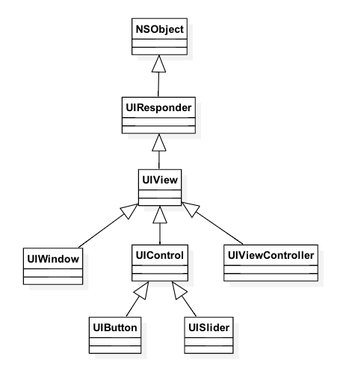
Native Apps iOS
MVC pattern
Controller
Manages the view
Works as a delegate for changes in the model
Provides an interface to access iOS frameworks (libraries)
Address book, event kit, message UI, telephony etc.
Application framework handles the navigation between views using controllers
View is a rectangle area on a window
Similar to QWidget inside QWindow

Slide 43
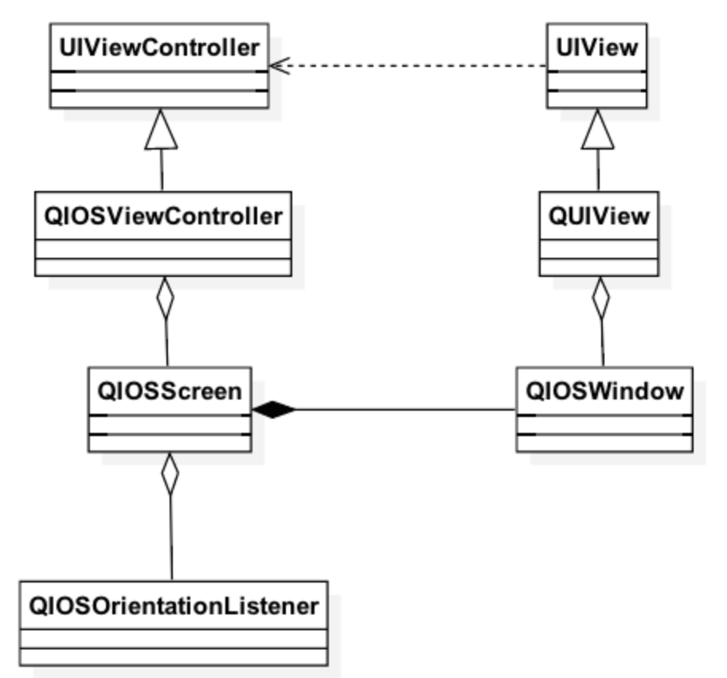
Qt iOS Apps
Based on Cocoa’s Model-View Controller Framework, provided by UiKit framework
UIController manages the memory and navigation between windows (views) – does not exist in Qt
UI view corresponds to Qt window
UI controls are sub-windows / views
QWindow mapped to UIViewController
Allows navigation to address book, calendar, messaging

Slide 44
Native APIs iOS
Possible to mix C++ and Objective-C
Use .mm suffix for your source code files
Add sources into OBJECTIVE_SOURCES variable in the .pro file
You may use QMAKE_INFO_PLIST variable to refer to your info.plist file
Get the native UiView from the .qpa plugin
UIView *view = static_cast<UIView *> (QGuiApplication::platformNativeInterface() -> nativeResourceForWindow("uiview", window()));

Slide 45
Native APIs iOS
Use UiView to get the UiViewController
UIViewController *qtCtrl = [[view window] rootViewController];
Set the delegate
Handles the callback after data have been picked or chosen
Create a new controller
Picker – pick an image
Chooser – choose a file
Navigate to a new view using the controller

Slide 46
Application Lifecycle

Slide 47
Application Lifecycle and Persistent Data
Both in Android and iOS, apps are suspended, when the user switches to another app
Furthermore, a suspended application may be removed from the memory at any time
Native states are mapped to Qt::ApplicationStates enumeration

Slide 48
Application States
Qt::ApplicationActive – foreground top-most focused application
Qt::ApplicationInactive – application is visible, but not in the foreground
Pause or stop video playback, games, animations, and sensors – i.e. stop using CPU
Qt::ApplicationSuspended – application is about to suspend and not visible
User presses Home Screen button and navigates to another application
Save app state into a persistent storage, if needed (QSettings)
In this state, app may be removed from the memory at any time
Qt::ApplicationHidden – background application
Music player

Slide 49
Thank you
NN@qt.io

